Slide 1


TEXT AND TEXT CONNECTIONS
Q4-W1-D4

Slide 2
Objective:
Recognize the type of intertextuality in a given text.

Slide 3
”Blast from
Tell whether each given statement is true or false.
the Past”
1. The non-linear arrangement of textual material is called hypertext.

Slide 4

2. Intertextuality converts a text into a multidimensional space.

Slide 5

3. A hypertext connects the studied text to media as a whole and stops the text from being isolated.

Slide 6

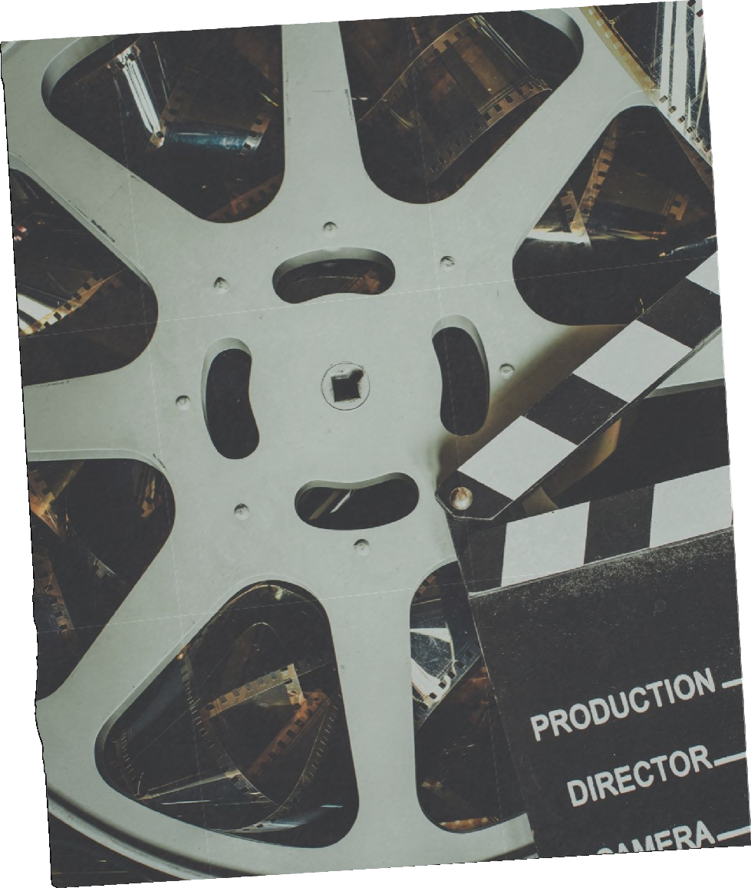


4. An intertext borrows ideas and themes from other media forms (eg. audio files, movies, theatre etc.).

Slide 7

5. The term hypertext was coined by Ted Nelson in 1965.

Slide 8
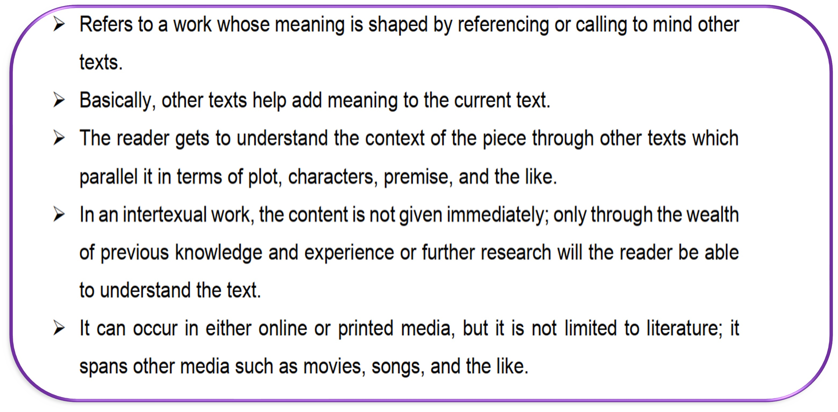
INTERTEXT

Slide 9
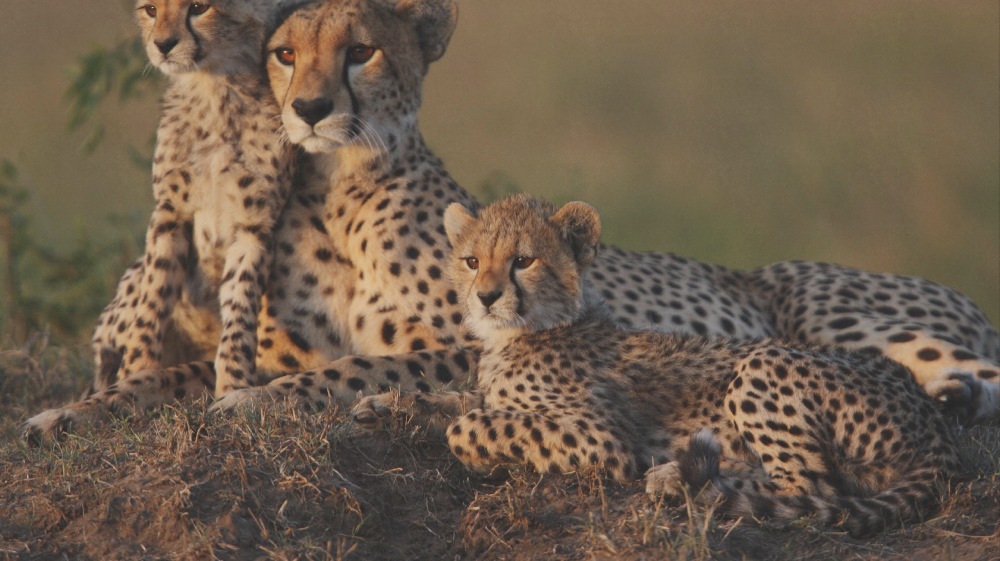
The Three Types
of Intertextuality

Slide 10
Adaptation (old becomes new)
1. Appropriation
Borrowing from another text
Reinterpretation
Reimagining an existing text and making it new

Slide 11

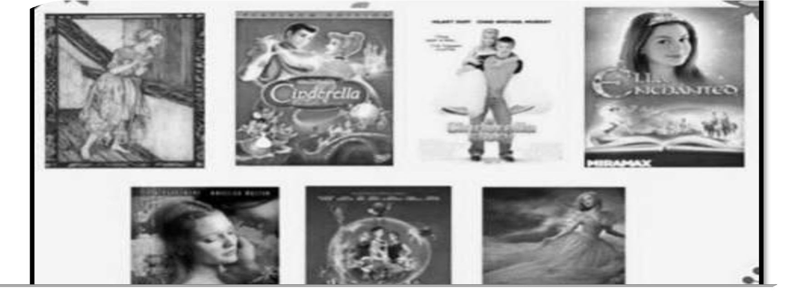
Examples:

Slide 12
2. Allusion
This is a reference to another text
It can also be a reference to a person, place or event. The audience / reader has to make the connection

Slide 13

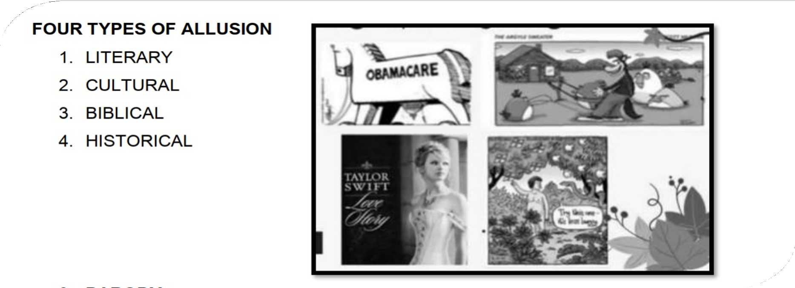
Examples:

Slide 14
3. Parody
A funny imitation of a serious piece of literature, writing, art or music.
Pokes fun at something to entertain the audience/ reader.

Slide 15

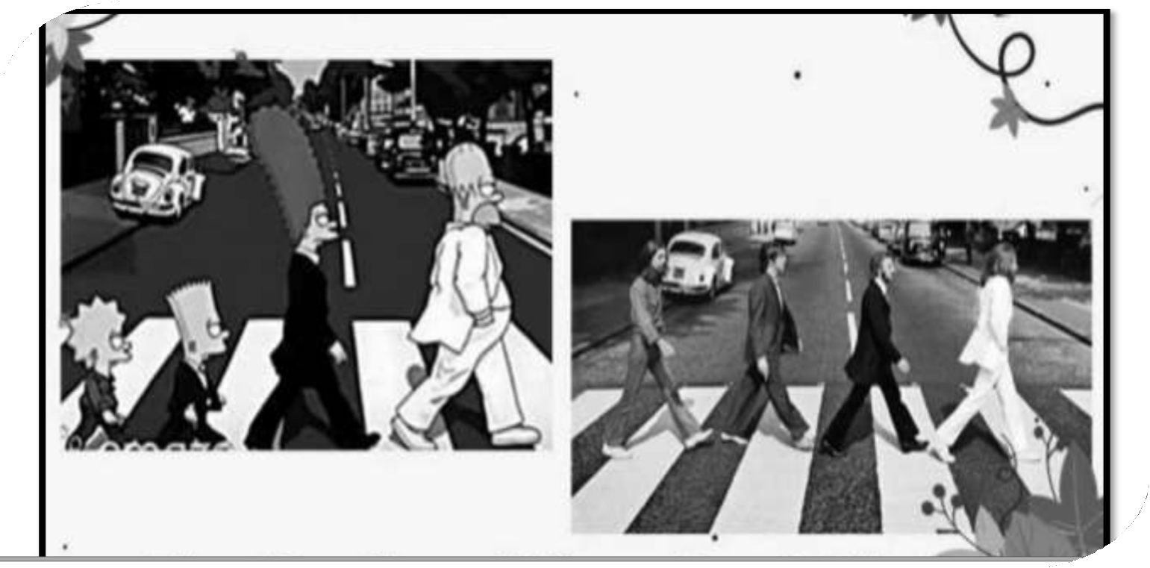
Examples:

Slide 16
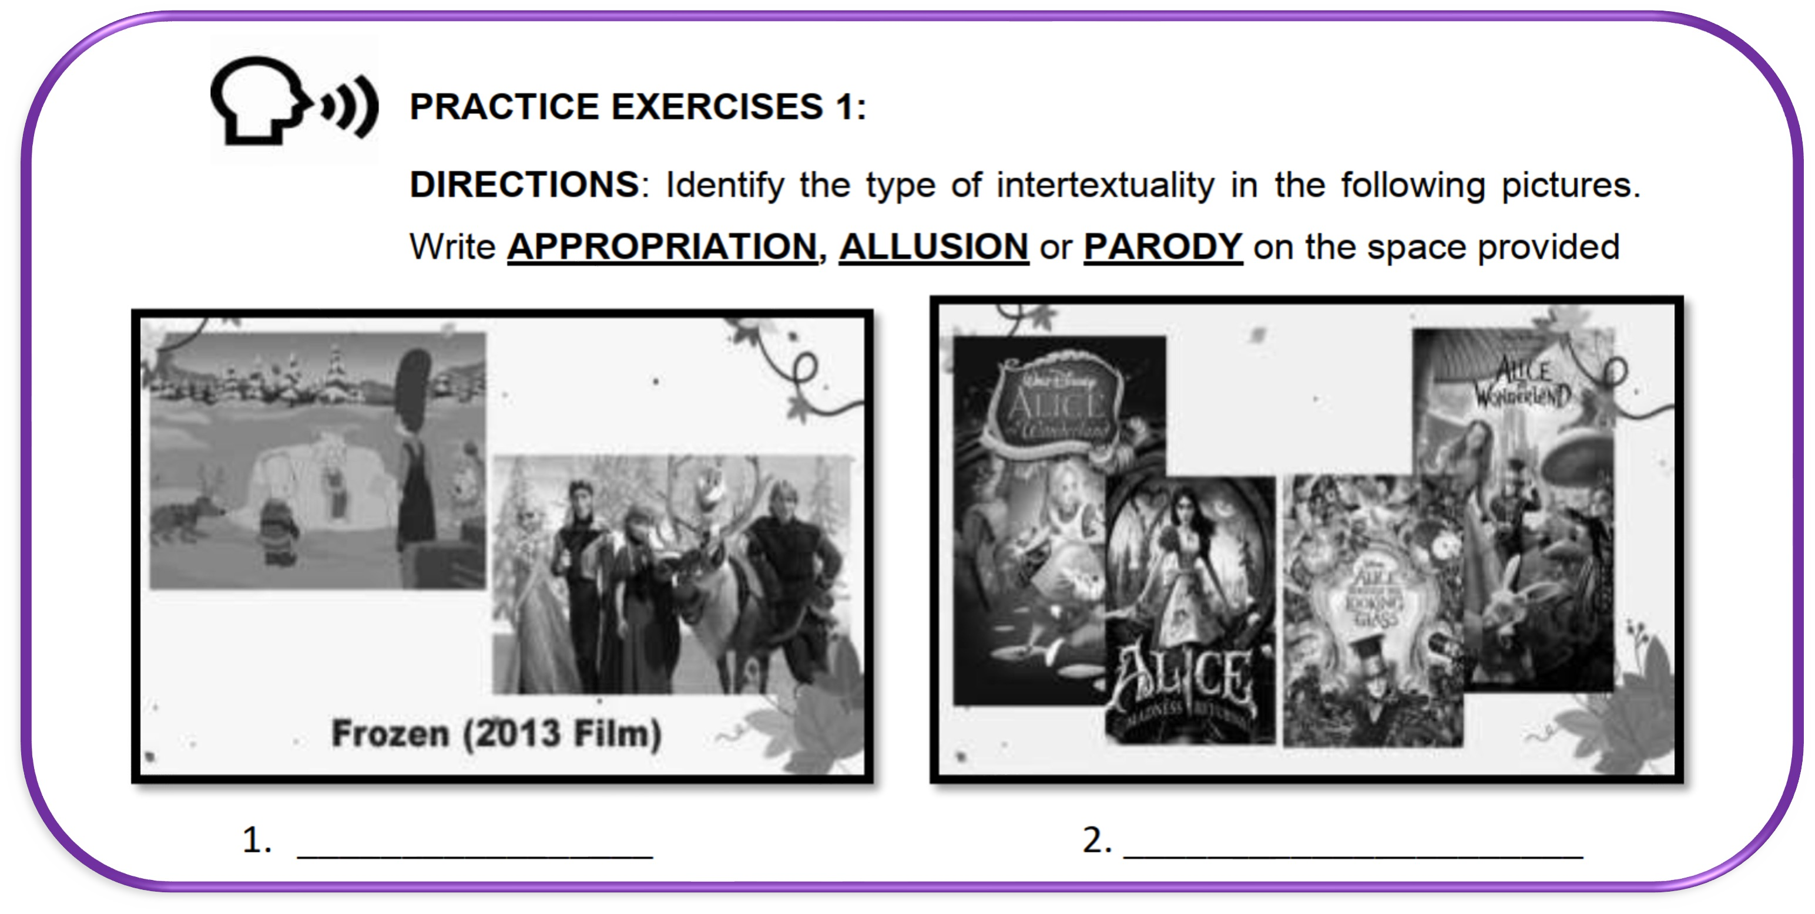
Letʼs Practice!

Slide 17
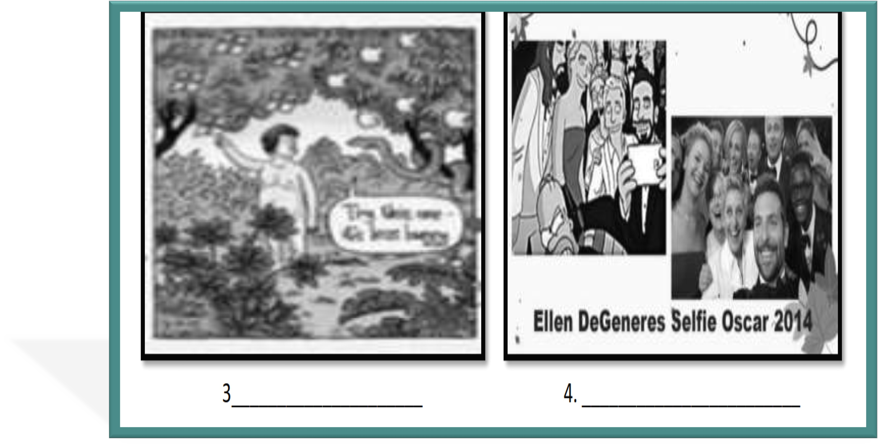

Slide 18



